Slide 1


Stock Market Trading Database Management System
Atharva Mohole Charmy Darji Harsha K Himanshu Mal Le Yu

Slide 2

Mission Statement
The primary mission of the Stock Market Trading Database Management System is to create and maintain a database that facilitates convenient stock buying and selling for traders, while enabling companies to list their stocks. The system aims to enhance the value of stocks and expand the reach of trading activities.
1
Transaction Handling
The system is designed to handle transactions and queries without compromising performance or security.
2
Encryption
The system implements encryption for sensitive data such as login credentials and trader information using symmetric key encryption and certificates.

Slide 3
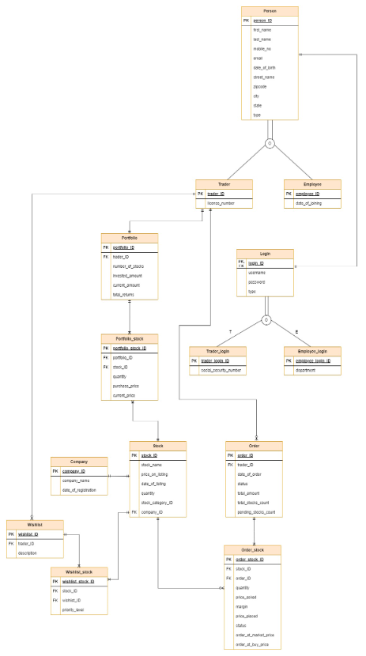
Entity Relationship Diagram

Slide 4
Database Schema Overview
1
Tables
2
Detailed Architecture
The database includes several tables to capture diverse aspects of the trading platform, such as Person, Trader, Employee, Company, Stock, and more.
It includes 14 tables, 3 views, 7 table-level check constraints, 3 non-clustered indexes, 3 stored procedures, 2 DML triggers, 2 computed columns based on user-defined functions and 3 column data encryption.

Slide 5




Business Logic Implementation
Stored Procedures
The system utilizes stored procedures like "allStocksOfATrader" for detailed stock information, "GetTraderPortfolioSummary" for a summarized portfolio overview, and "GetTraderStocksAndOrders" for a consolidated view of a trader's stocks and orders. These procedures enhance the efficiency and accessibility of the stock trading experience.
Triggers
The system's triggers, such as "UpdateOrder" and "UpdatePortfolioStockCurrentPrice," automate critical processes like adjusting pending stock counts and dynamically updating stock prices in portfolios. These triggers enhance the efficiency and responsiveness of the stock trading platform.
User Defined Functions
Computed columns in the Stockmarket Trading System, such as "total_value" and "total_stock_value," leverage user-defined functions like "CalculateStockValue" and "TotalStockValue." These dynamic columns provide real-time assessments of individual stock values and overall portfolio worth, aligning with the system's goal of delivering timely financial insights to traders.

Slide 6
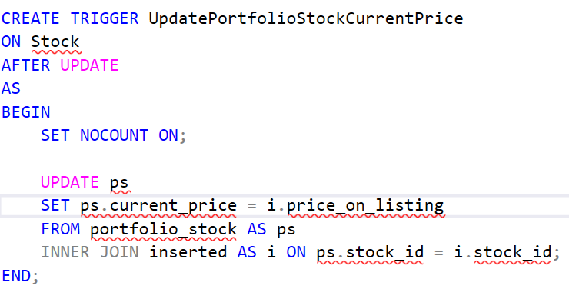
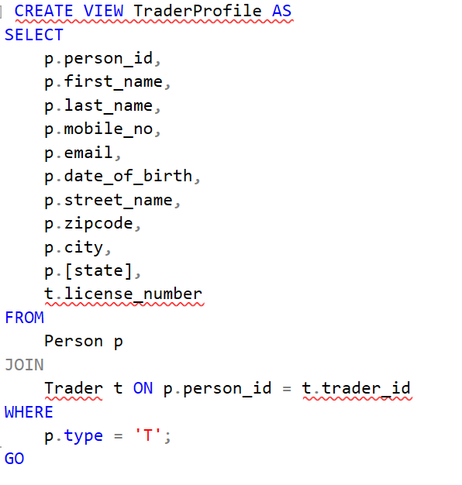
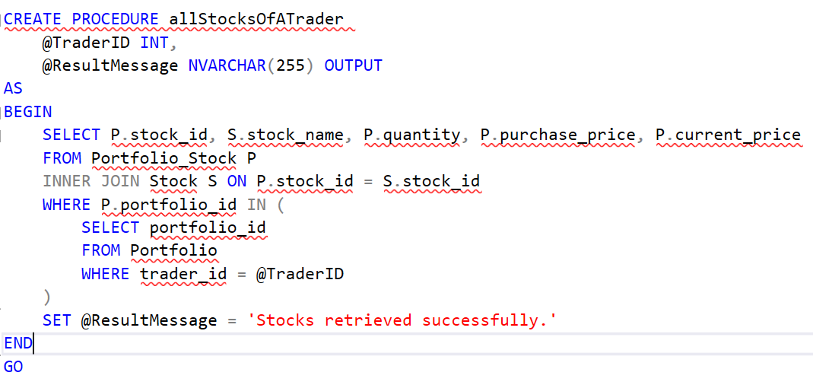
Stored Procedures, Views, Triggers

Slide 7
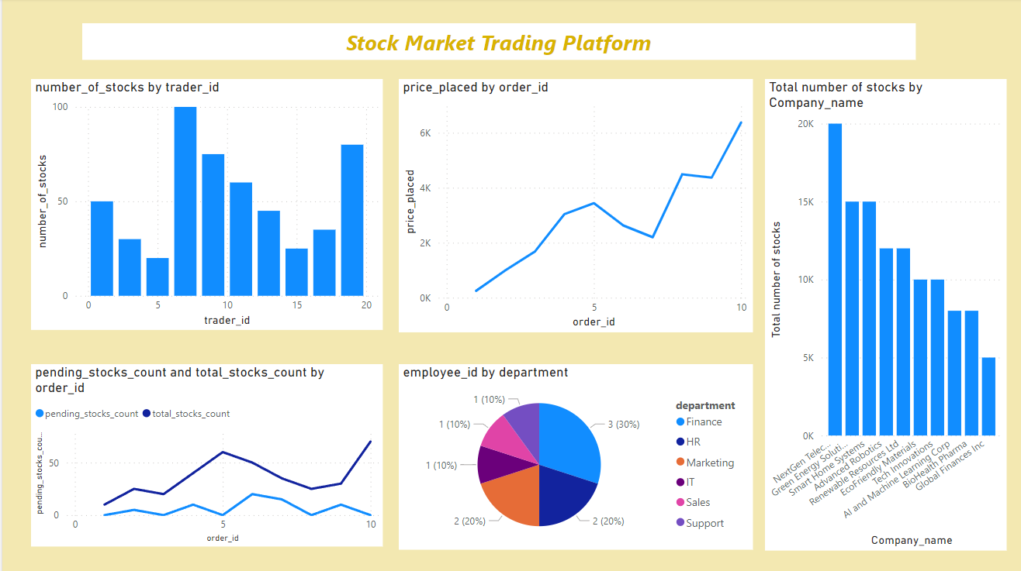
POWER BI INTEGRATION

Slide 8

Conclusion
The Stock Market Trading Database Management System is a comprehensive solution designed to meet the needs of both traders and companies participating in the online stock market. It focuses on efficient transaction handling, robust security measures, and scalability to provide a seamless and secure trading experience for all stakeholders.

